Slide 1
AEDC Strategic Vision
Anchorage’s Economic Future

Slide 2
What does AEDC do?
AEDC was founded in 1987, a time of deep recession in Alaska, by members of the business community who felt that we could be doing more to attract, retain, and grow business investment in Anchorage
Since then, AEDC has been stewarded by its members and Board of Directors to help create and foster a fertile environment for business, both local and global
In 32 years, we have managed hundreds of projects, and witnessed a rapidly changing landscape for economic development around the world

Slide 3
1987 - present
Past Projects
Ongoing
Economic data and business assistance
Marketing Anchorage and Alaska to national and international business
Alyeska Resort
FedEx & International Cargo Development
Vision Anchorage Strategic Initiative
Multiple Workforce Development Initiatives
Big Wild Life Branding
Live.Work.Play.
Angel and Venture Capital Funding, and Entrepreneurship
ML&P Sale
AeroNexus Project
Manufacturing, Distribution, Tourism & General Economic Development

Slide 4
What works, and what doesn’t
Full and Partial Successes
Unsuccessful
Fedex project led to massive expansion of air cargo business at ANC
Alyeska Resort a significant asset to tourism
Workforce development
Angel/venture capital availability significantly increased
Live.Work.Play. Housing initiative
AEDC national/international marketing, data research, business assistance
Vision Anchorage Collaboration
International tourism marketing
Workforce development
Manufacturing attraction
Distribution attraction

Slide 5
Site selection: the old model
Site selectors are consultants that work for companies looking to expand into new geographies
The “old” economic development model involved bringing site selectors to Anchorage, touring, wining and dining them, and persuading them of the benefits of investing in Anchorage
Over more than a decade, we compiled feedback from dozens of site selectors who consistently said we lacked the quality of life factors – including skilled workforce – that their clients required

Slide 6
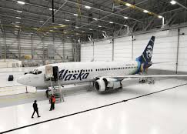
What about our airport?
Over the past five years, we have pursued new investment opportunities at the Ted Stevens Anchorage International Airport
We were consistently told by potential logistics investors that our product offering is not adequate
Connectivity with the rest of the world is great, but real estate quality, available skilled workforce, and infrastructure is lacking

Slide 7
Anchorage competes with the world
Cities that are experiencing economic growth are successful at attracting talented professionals
In the new global economy, business chases talent, and talent chases place
Anchorage is losing this competition – not just to large metropolitan areas, but to other mid-sized cities with similar economic and climate profiles
If we cannot succeed in attracting and retaining talent, we will fail to diversify and grow our economy

Slide 8
What do Anchorage businesses need?
Each year, AEDC surveys the Anchorage business community to ask about the biggest barriers to the growth of their business – these are the top 10:

Slide 9
Who is winning the competition for talent

Slide 10
Placemaking: the new model
What it takes to be the best place…
Talented professionals today choose where they want to live first, before they find a job, because place is a more important factor than any particular job
Cities must identify the characteristics that make them livable and lovable and invest in those to attract the talent they need to survive

Slide 11
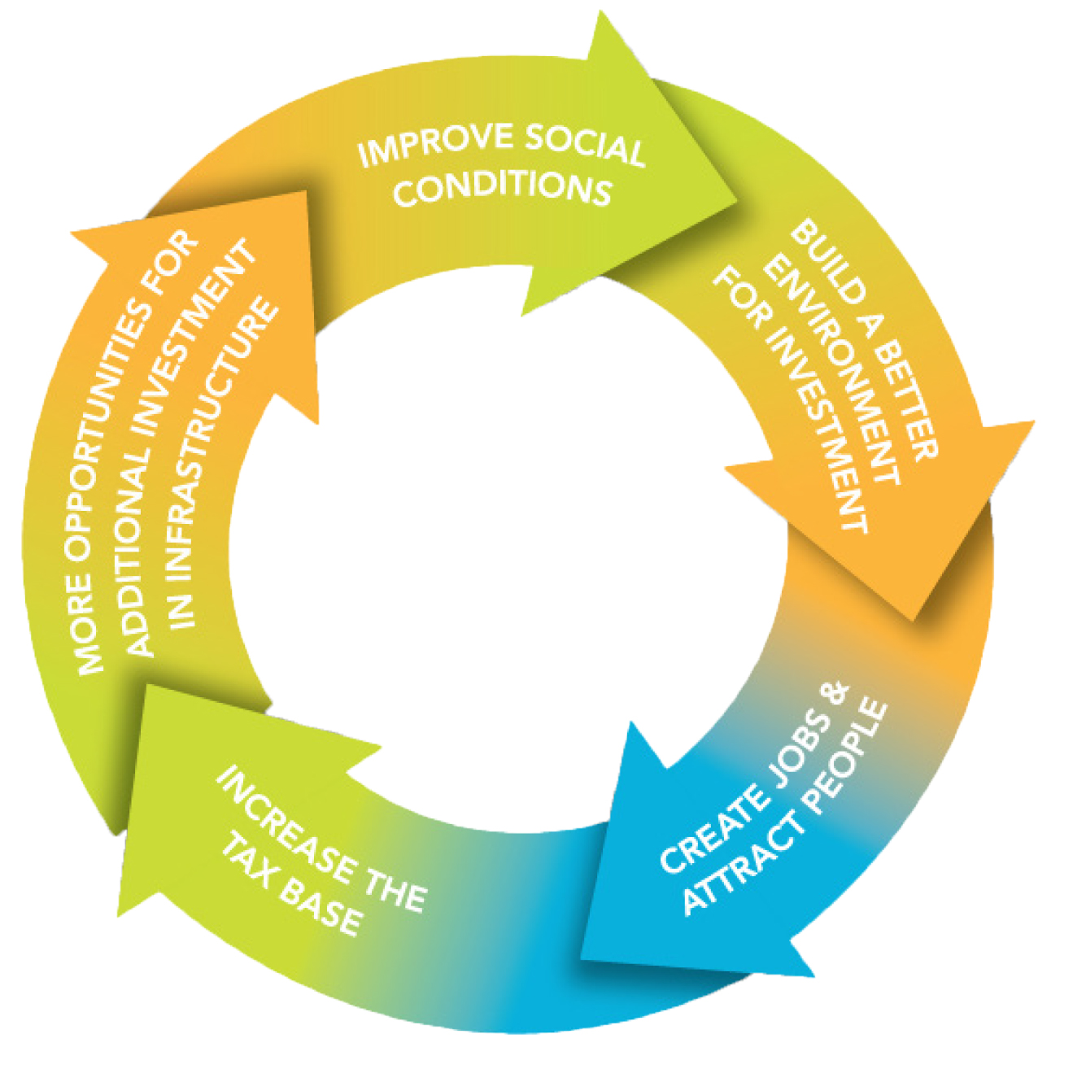
Placemaking in Anchorage
The old model of economic development, relying on low taxes and a business-friendly regulatory environment, was and is not enough to attract new investment to Anchorage. In 2010, our Board recognized that in today's economy, business chases talent, and talent chases place.

Slide 12
Where we started
Live. Work. Play. was born as a placemaking initiative to improve livability in Anchorage, ultimately making the city a destination for talented professionals and the business investment that chases them.

Slide 13
Progress to date
Lack of new investment in Anchorage continues because of perceived fundamental issues in the "product" that we are offering: a city with quality of life issues making us uncompetitive with cities of similar size and climate, such as Boise, ID, Bozeman, MT, Bend, OR.

Slide 14
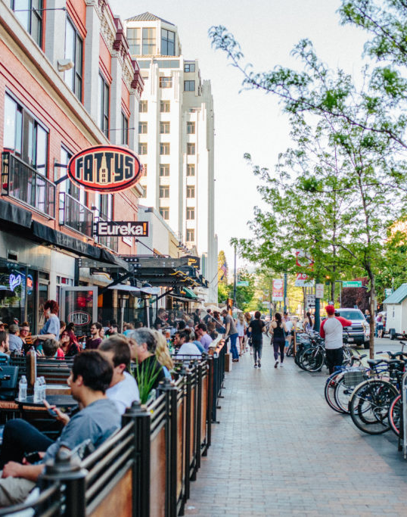
Case study: Boise
Major public investments in “complete streets” downtown, walkability and bikability year round, public art, and outdoor recreation infrastructure
Home to Boise State University, the city has continued to attract major regional tech companies, agribusiness, and entrepreneurship because of the access to an urban lifestyle with outdoor perks, such as skiing, fishing, hiking, and cycling

Slide 15
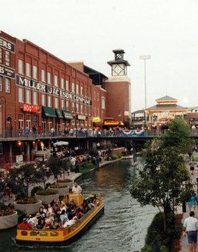
Case study: Oklahoma City
Introduced a 1% sales tax to exclusively fund public improvement projects, including a new sports stadium, walkable canal district, electric trolley downtown, and housing incentives
An alliance of business associations and investors created a list of priority funding projects, known as MAPS, and proposed the ballot initiative after OKC lost a multi-hundred million dollar investment opportunity

Slide 16
What do these cities have in common?
Public investment in a sense of “place”
Support and interconnection with public universities
Vibrancy, arts, culture and housing downtown with robust transportation options
Easily accessible outdoor recreation opportunities

Slide 17
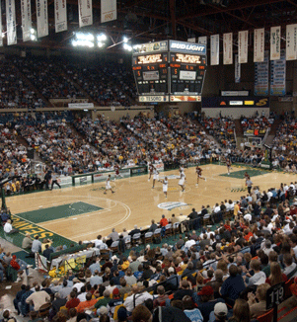
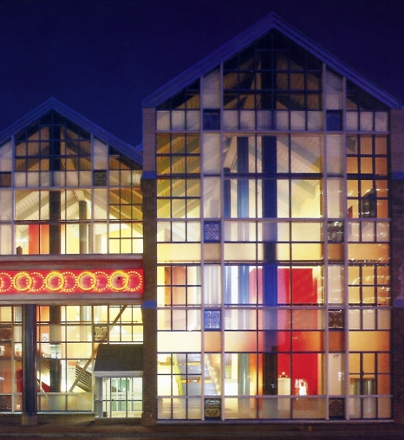
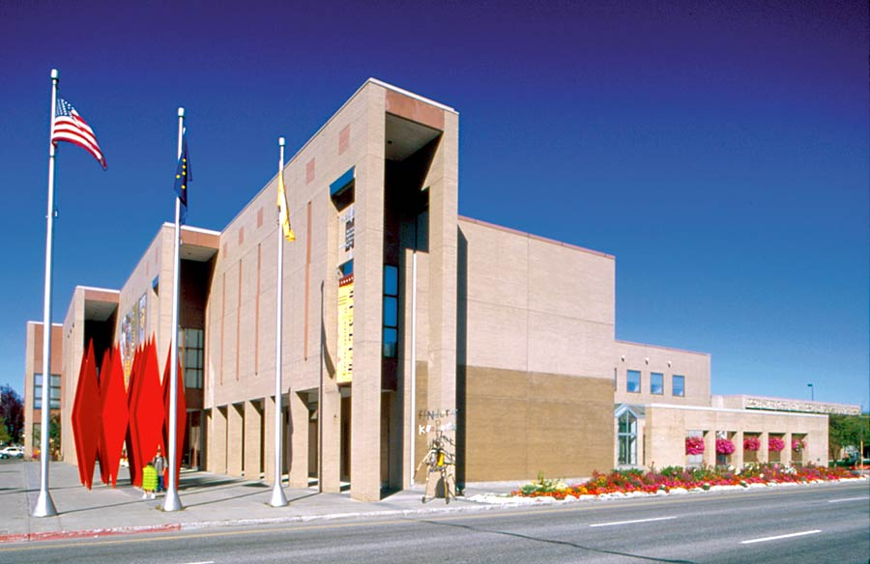
Anchorage’s last major public investment initiatives were Project 80s and the Dena’ina Center

Slide 18
In Anchorage, public investment is lacking
$14,403
$11,624
$11,055
$10,069
$9,290
$6,577
$6,404
$2,902
Source: District of Columbia Chief Financial Officer, Tax Assessments for the Largest Cities in Each State including D.C., 2016

Slide 19
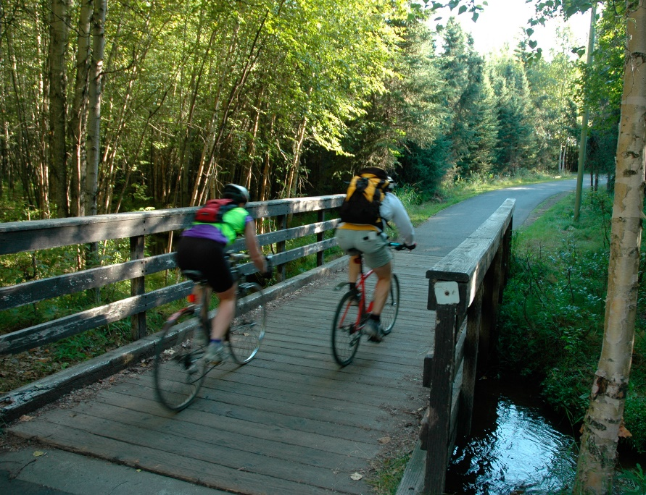
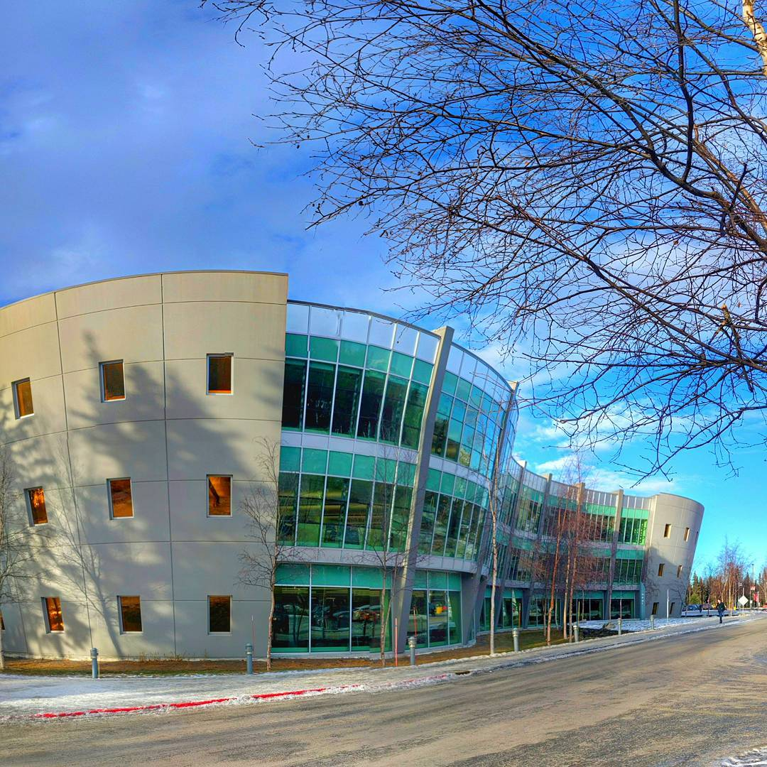
THE THREE-PRONGED PLAN
It all starts downtown
Chester Creek Greenbelt connects us
U-Med is our hub
Walkability
Mixed-used residential and high-density housing
Programming and events
Sports and recreation year-round
Multi-modal transit
Mixed-use residential at Chester Creek Sports Complex
Workforce housing
Retail development
Intersection between community and campus
Notes:
https://www.google.com/imgres?imgurl=http%3A%2F%2Fwww.wintercityedmonton.ca%2Fwp-content%2Fuploads%2F2016%2F11%2FWCFeaturedDesignGuidelines-660x660.jpg&imgrefurl=http%3A%2F%2Fwww.wintercityedmonton.ca%2F&docid=V4MQLfrXvMAAuM&tbnid=OWcc-b4oPN-maM%3A&vet=10ahUKEwjfhuzxpMDTAhVM7WMKHX2lAGAQMwiAAShSMFI..i&w=660&h=660&safe=off&bih=974&biw=1920&q=winter%20city%20edmonton&ved=0ahUKEwjfhuzxpMDTAhVM7WMKHX2lAGAQMwiAAShSMFI&iact=mrc&uact=8

Slide 20
How do cities pay for placemaking?
Cities around the country use a myriad of financing strategies to increase public investment and improve the livability of their community
A few examples:
Façade improvement loan and grant programs
Property tax moratoriums in targeted neighborhoods
Local option sales tax (e.g. Oklahoma City)
Revolving loan funds
Tax increment financing
Public private partnerships
Multiple financing strategies can be used together to create robust public investment

Slide 21
Thank you!
Today is just the beginning of a conversation about how to truly make Anchorage the best city to live, work and play
We value your feedback, and want to engage with our members as much as possible as we pursue the goal of improving our product offering, helping our business community grow and attracting and retaining a talented workforce
Thank you for your time and commitment to Anchorage’s future!

Slide 22
Thank you!
AEDC Board of Directors
Lynn Rust Henderson, Premera BCBS
David Knapp, BP Alaska
Steve Noble, DOWL
Raquel Edelan, Hotel Captain Cook
Michael Huston, Northrim Bank
Marilyn Romano, Alaska Airlines
Julie Taylor, Alaska Regional Hospital
Martin Bettis, Signature Flight Service
Michael Prozeralik, KPB Architects
Laura Edmondson, Bering Straits Native Corp.
Peter Pounds, GCI
Garret Wong, Capital Management Benefit Corp.
Charles Grimm, BAC Transportation
Dave Cavitt, Furniture Enterprises of Alaska
Lon Wilson, The Wilson Agency

